Slide 1
Project: A Search for Robot Navigation with Dynamic Costs
Afrin Sultna Akhi
22101095
3-2(Sec B)
MM/DD/20XX

Slide 2
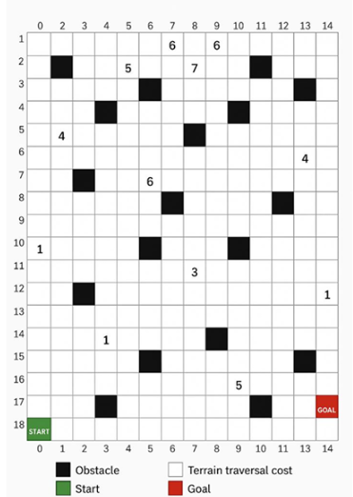
Table of contents
01
04
02
05
03
06
Introduction
Methodology
Problem Statement
Input Output Result
Objectives
Conclusion

Slide 3
Introduction
Robots in warehouses need efficient path planning
Must consider:
Obstacles (impassable cells)
Terrain costs (different surfaces)
8-directional movement (with diagonal penalty)
Goal → Find minimum-cost path using A* search

Slide 4
2. Problem Statement
Grid-based environment (m × n)
Movement Rules:
Horizontal/Vertical → cost = terrain cost
Diagonal → cost = 1.4 × terrain cost
Input: grid size, obstacles, terrain costs, start & goal
Output: Optimal Path, Path Cost, Explored Nodes, Runtime

Slide 5
Implement intelligent navigation system
Compare Manhattan, Diagonal, Euclidean heuristics
Evaluate:
Path Cost
Path Length
Explored Nodes
Runtime
Identify best heuristic for efficiency
3. Objectives
Sample Input:
5 5
2
1 1
3 3
3
0 1 2
1 2 3
2 2 5
0 0
4 4

Slide 6
Methodology
Algorithm: A* Search
Cost Calculation:
g(n): path cost from start → node
h(n): heuristic (Manhattan / Diagonal / Euclidean)
f(n) = g(n) + h(n)
Track:
Explored nodes
Path reconstruction
Implemented in Python
Heuristics
Manhattan Distance = h=∣dx∣+∣dy∣h = |dx| + |dy|h=∣dx∣+∣dy∣
Diagonal Distance = h=max⁡(∣dx∣,∣dy∣)h = \max(|dx|, |dy|)h=max(∣dx∣,∣dy∣)
Euclidean Distance = h=dx2+dy2h = \sqrt{dx^2 + dy^2}h=dx2+dy2​

Slide 7
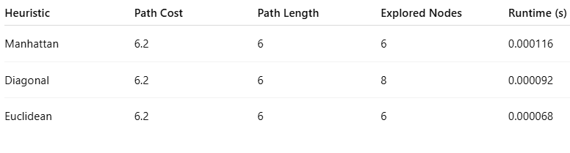
Sample Output (Manhattan)
Path: [(0,0), (1,0), (2,1), (3,2), (4,3), (4,4)]
Path Cost: 6.2
Explored Nodes: 6
Runtime: 0.000116s (Insert path illustration on grid)
Results Comparison

Slide 8
Analysis
Conclusion
All heuristics gave same optimal path & cost
Euclidean → best performance (fewest nodes, fastest runtime)
Diagonal → explored more nodes, less efficient
Manhattan → works well but not tailored for diagonal movement
A* with terrain costs successfully finds minimum-cost path
Euclidean heuristic → best overall performance
Useful for warehouse robots, logistics, and path planning

Slide 9

Future Work
Dynamic environments with moving obstacles
Real-time replanning (D*, LPA* )
Integration with real robots
Adding energy/battery constraints

Slide 10
Thank you

